Slide 1


Biogas meter development and evaluation
Jakub Tkaczuk
26 Nov 2024
Date

Slide 2
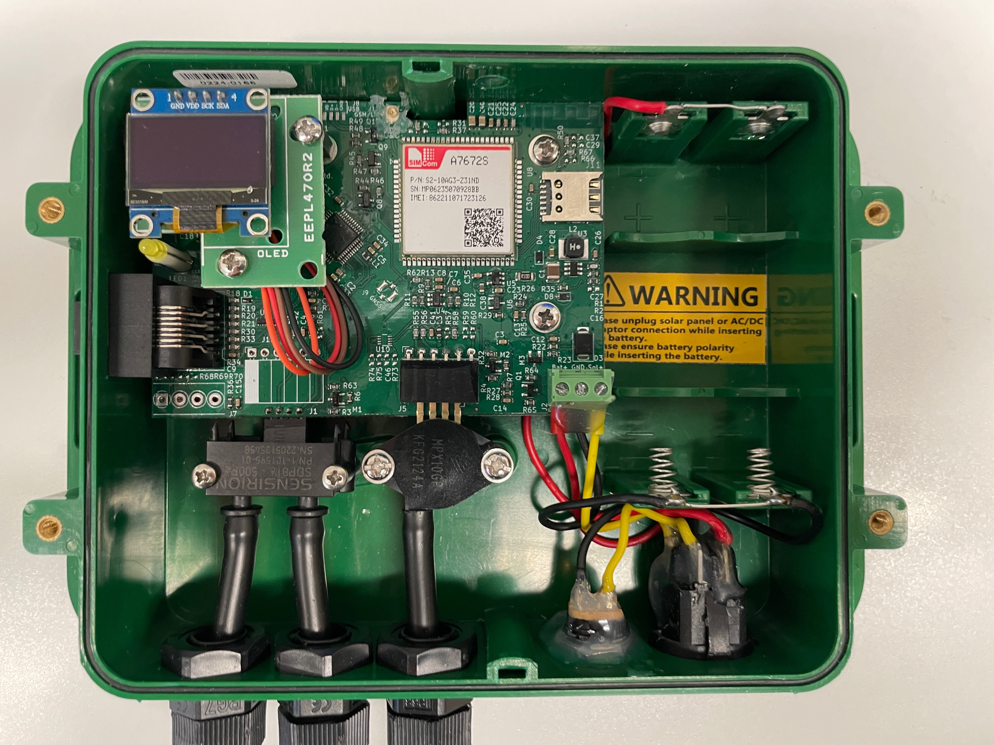

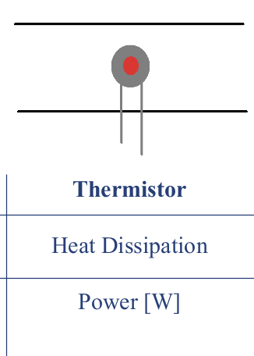
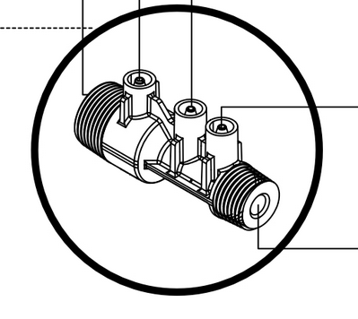
Smart Biogas flow sensor
GHE flow sensor
Sensors not appropriate for environments with corrosive gases (e.g. H2S & ammonium)
A single thermistor in a tube
Heat dissipation is correlated with flow
Some thermistors have a protection coating against corrosive gases
Venturi restriction : questionable accuracy
Jakub Tkaczuk
26 Nov 2024
2
Notes:
2

Slide 3
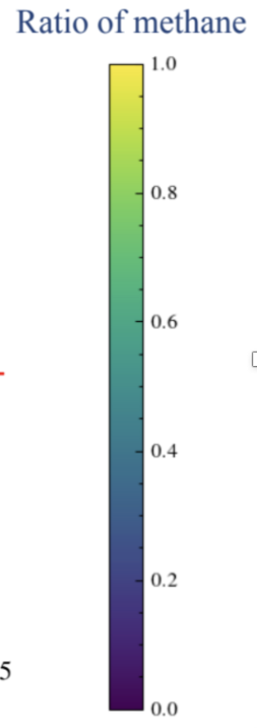
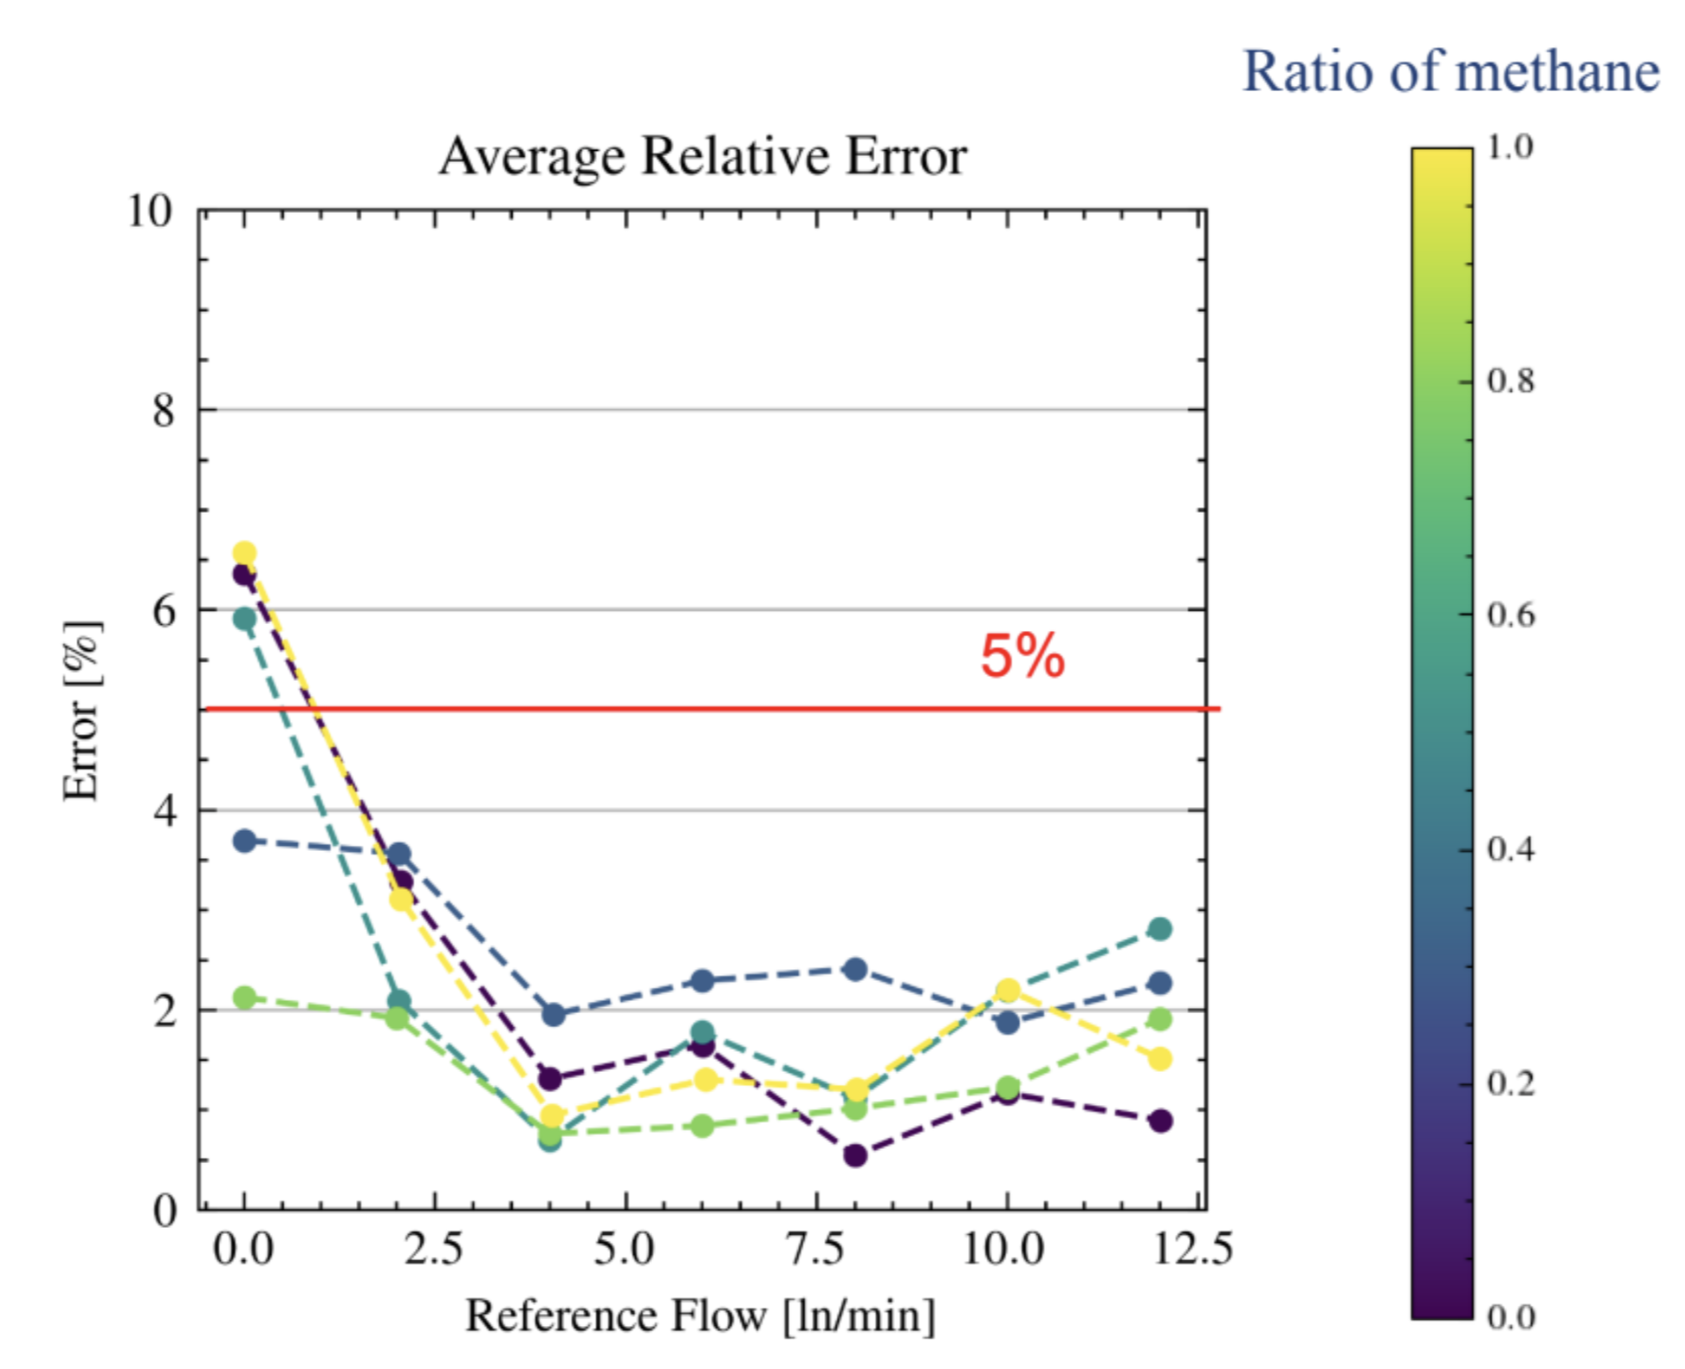
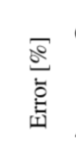
Smart Biogas flow sensor
GHE flow sensor
> 100% error!
Jakub Tkaczuk
26 Nov 2024
3
Notes:
3

Slide 4
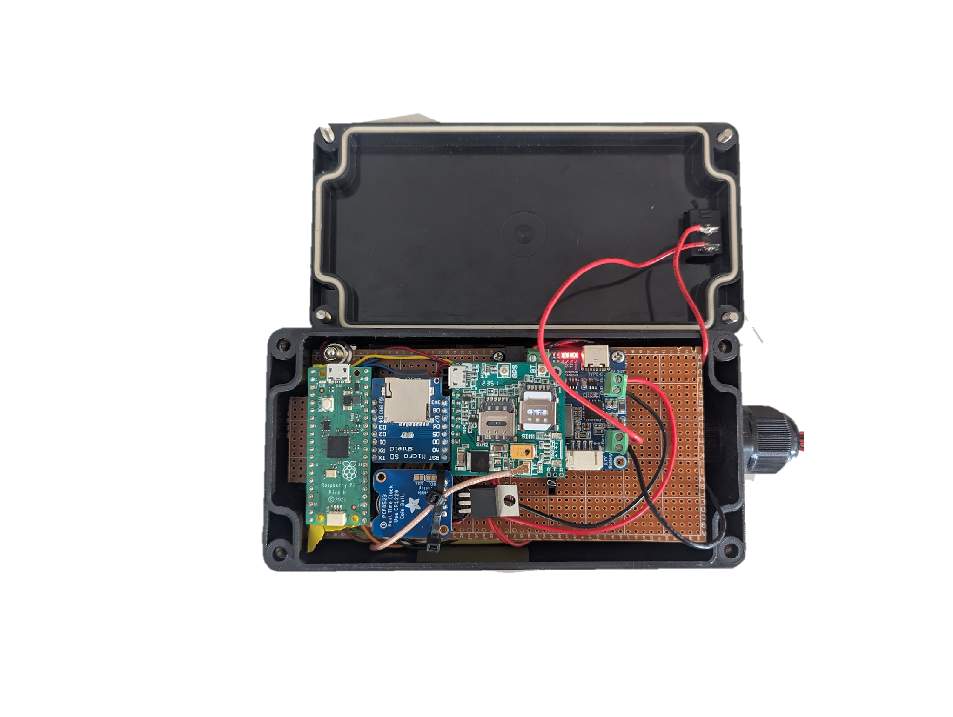
Other aspects in development:
Remote communication (4G, GSM)
Data platform
Power management (low power)
Manufacturability

Slide 5
Introduction
Goals
Methods
Results
Conclusions
Relevant research projects
Title | Status
Life Cycle Analysis of biogas digesters | In-progress
Estimating uncertainty in past biogas offset projects and methodologies | In-progress
Testing the accuracy of the smart biogas measurement device | In-progress
Impact of Hydrogen Sulfide on Biogas Burning and Removal Evaluation | In-progress
Title | Status
Casing design, manufacturing and testing for in-situ biogas monitoring | Done
Monitoring of improved cookstoves: from prototyping to small batch manufacturing | Done
Logging and transmitting remote data from cookstove and biogas sensors in Malawi | Done
Volumetric flow meter development for household scale biogas reactors | Done
Developing a Methane Sensor for Biogas reactors in Malawi | Done
Development of a Monitoring Device for Improved Cookstoves | Done
Biogas sensor development: from prototyping to production | In progress
In-situ testing of gas monitoring at biogas plant in Switzerland (ZHAW) | Upcoming
Author‘s name
Date
5
Notes:
5

